Slide 1
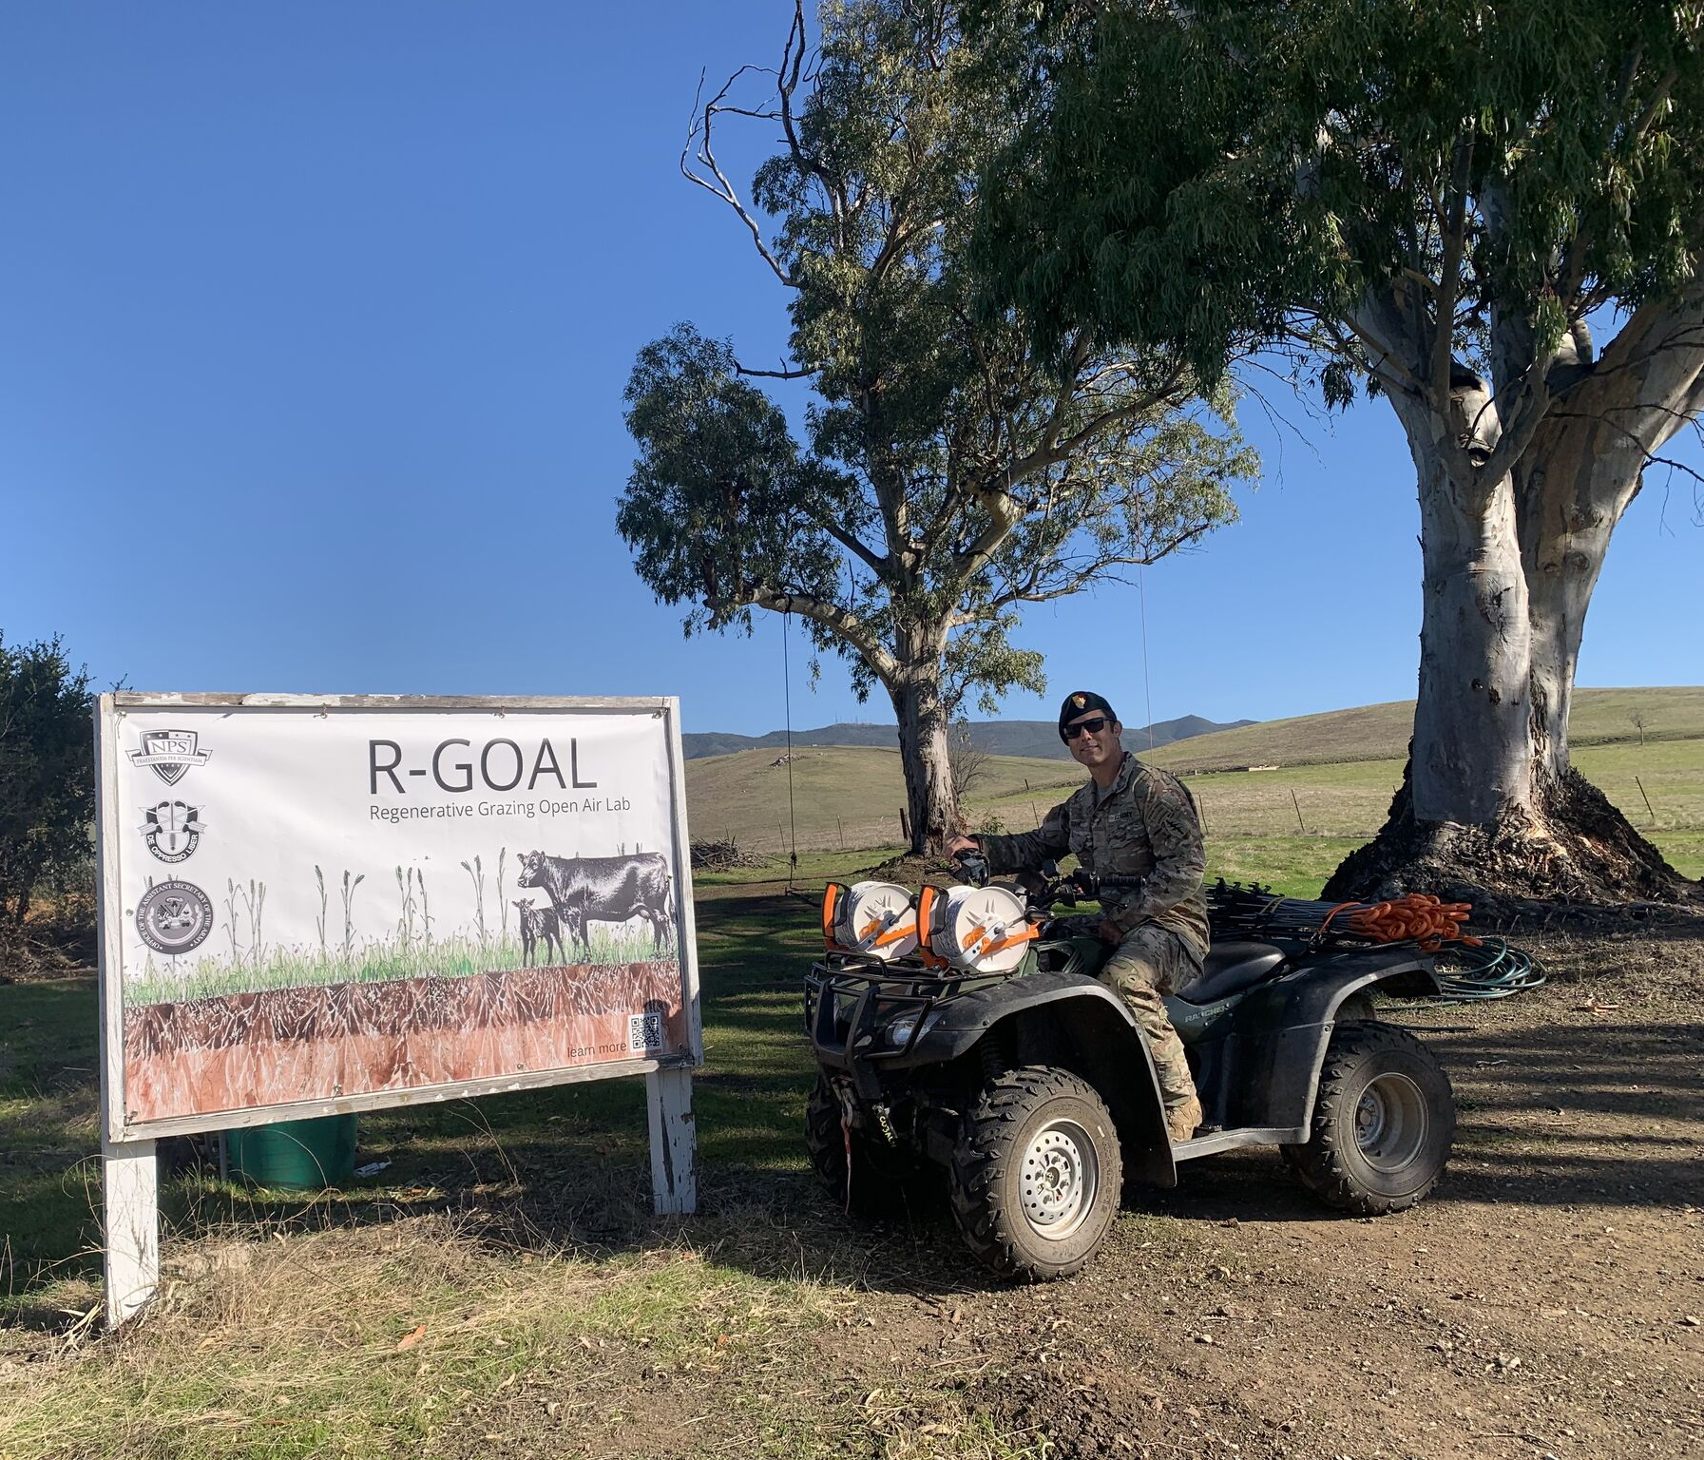
Regenerative Grazing Open Air Lab
MAJ Eric Czaja
January 27, 2025
Notes:
OPENING SLIDE

Slide 2
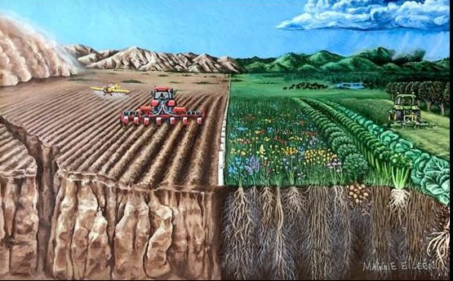
Regenerative Agriculture defined
Regenerative Agriculture –
Farming and ranching in synchrony with nature to repair, rebuild, revitalize and restore ecosystem function starting with all life in the soil and moving to all life above the soil.
Conventional Regenerative

Slide 3
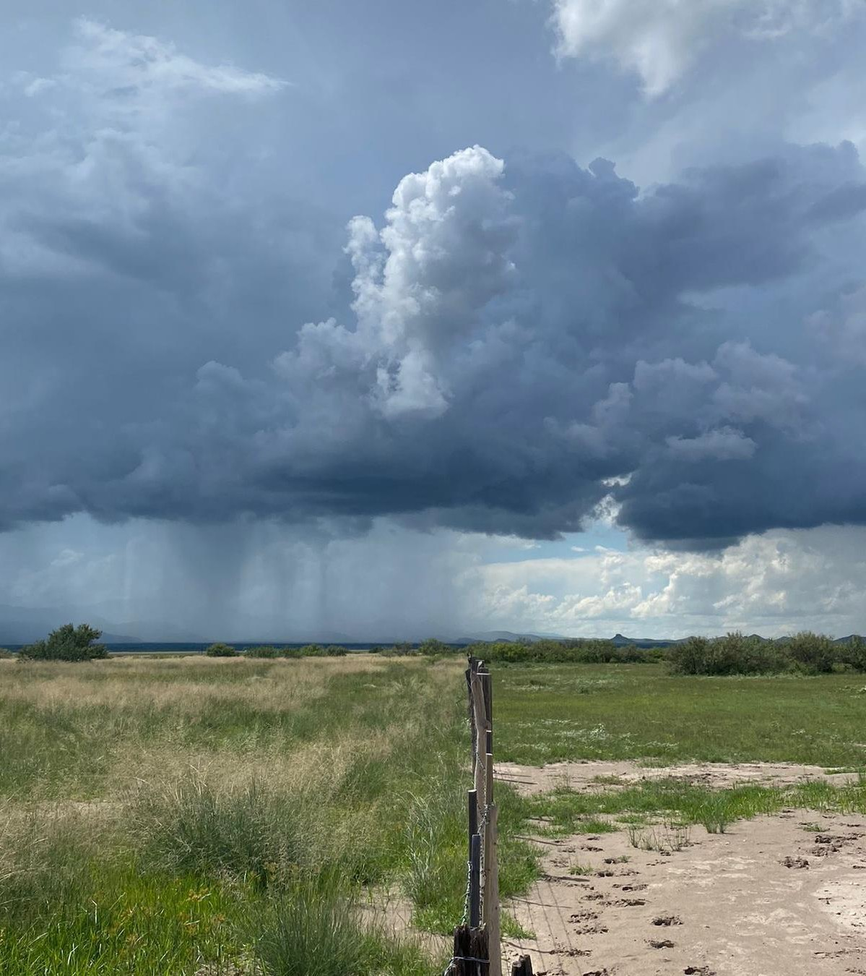
Regenerative Agriculture defined
Regenerative Agriculture –
Farming and ranching in synchrony with nature to repair, rebuild, revitalize and restore ecosystem function starting with all life in the soil and moving to all life above the soil.
Conventional Regenerative

Slide 4
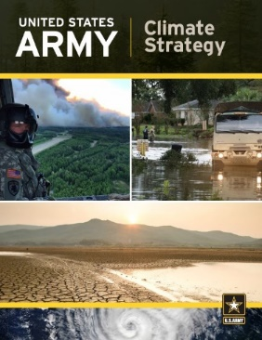
Research Question
Army Climate Strategy
Focuses on reducing Greenhouse Gasses
Goal Net Zero Emissions NLT 2050
LOE 1 is Installations
Army owns or manages 13 million acres
Current and Former Ag Leases
REPI/ACUB land
Through regenerative agriculture practices to what extent can the Army sequester carbon on owned and managed land?
Goals
Increase carbon in the soil
Increase biomass below and above soil level and extend the green season of perennial and annual grasses
Regulate soil temps across seasons (cooler soil temp in summer & warmer soil temps in winter)
Capture more rainfall (improve water infiltrate rates)
Improve wildlife habitat

Slide 5
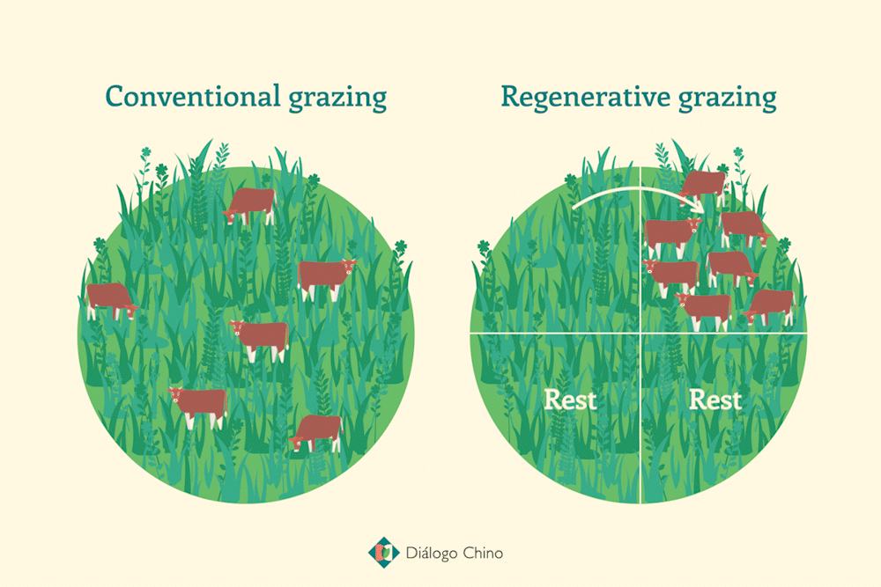
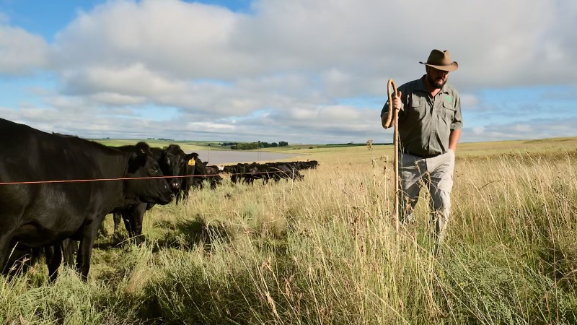
Regenerative Grazing Proof of Concept
Regenerative Grazing
Biomimicry
Daily Moves
Local Ranchers supply the cattle
Installation provides Land Access
Regen Ag Compliant Grazing
Regen Ag Consultant Oversight
Suite of Benefits
Increase Warfighter training efficiency
Carbon Sequestration
Decrease costs
Wildfire reduction
Enhanced CIV/ MIL relations
Increased water infiltration
Return to perennial grasslands
Biodiversity
Notes:
https://www.capitalpress.com/ag_sectors/livestock/new-study-cattle-grazing-significantly-reduces-wildfire-spread/article_4e57a21c-f2b2-11ea-bfcc-7fbfbde3935e.html?fbclid=IwAR1av0aFjebJaseAnAgr0NnlEHTazET93zOnesbIui5m7PE49_SbIeBrzGo

Slide 6
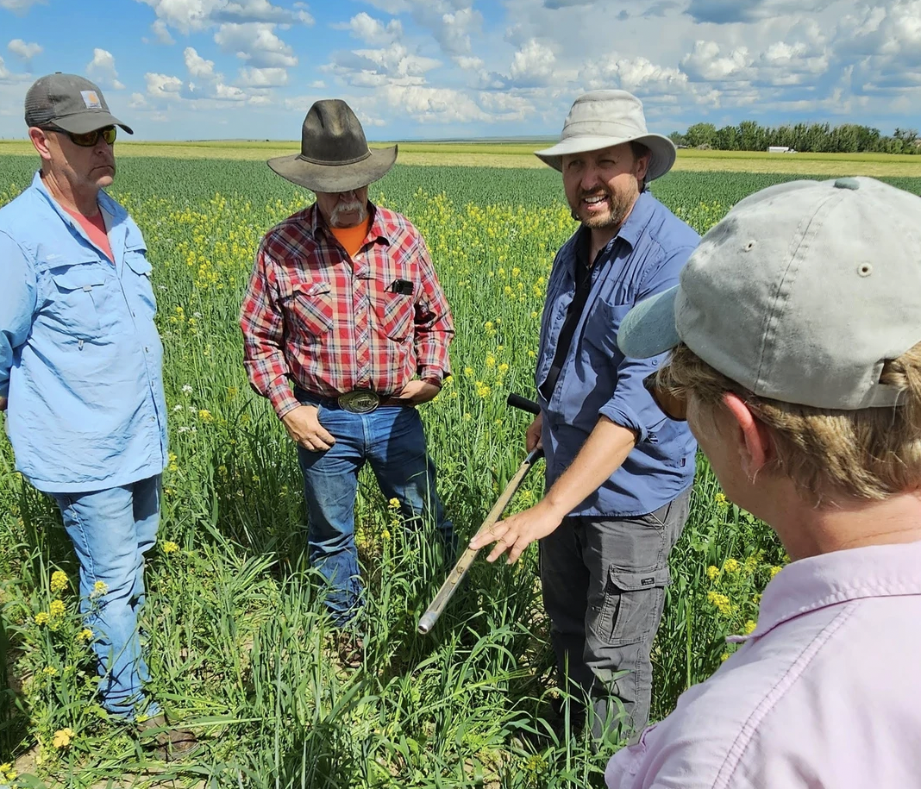
Regenerative Grazing Proof of Concept
Measurements - Ecdysis
Initial & Year 5 Carbon Measurement
Plant Biomass
Water Infiltration Test
Microbial Communities
Invertebrates
Birds
Forage Production
Management and Economics
Phase 1
Phase 2
Phase 3
Phase 4
Phase 5
Research proposal
IE&E Approval
Funding
Pilot Location
(NPS) Budget Submission
Base Approval
Consultant Assessment
Grazing w/UA
Base/UA/ Partner Quarterly Sync *Recurring
Baseline Measurements
Annual Measurements
Implementation model developed
Data published
Site expansion
Notes:
Ecdysis Measurements
Camp Roberts will fill out a pre-survey that populates a practice-based scoring system that places a farm along a continuum from very conventional to very regenerative (Fenster et al 2021). These scores will be verified upon site visits, and using a final, post-season management survey. The end result is scores for each farm that span 1-8 for cropland, rangeland, orchard, and vineyard systems, with higher numbers being the most regenerative. All measurements except for management surveys and bird counts will be replicated in four separate areas of each pasture.
Soils. The team will aggregate 17 cores from each of four transects will be aggregated into two sets of samples. A single cylindrical sample 7.6 × 7.6 cm (diam., depth) will be used to collect bulk density. A set of 12 cores will be collected at the depth of 0-15 cm (2.5 cm diam.), aggregated into a single sample per transect, and subjected to Haney analysis. A final set of 4 deep probes (2.4 × 60 cm diam., depth) was stratified (at 0-5, 5-10, 10-15, 15-30, 30-60 cm depths) and aggregated into a single sample for each of the five layers. Carbon, nitrogen, and micronutrient assessments are performed independently for each strata. An archive of each soil sample is housed at Blue Dasher Farm, Estelline, SD, 57234.
Water. On each transect, a single water infiltration ring (15 × 7.6 cm diam., depth) is observed for 15 min. The duration that it takes 444 mL of water to infiltrate the soil will be recorded. If the water completely infiltrates in the allotted time, a second volume of water will be added. A mini-disk infiltrometer will be used to measure the hydraulic capacity of the soil at a single site per transect. A microprobe is inserted 7.6 cm into the soil at three locations along each transect, and the water content of the soil is recorded. The wet and dry weight of the bulk density core will be recorded to provide a single observation of gravimetric water content per transect.
Microbial communities. The microbial communities will be measured in subsample of the 0-15 cm deep composites that were devoted to the Haney test. Soil respiration (CO₂ produced) is one of the outputs of the Haney test. Phospholipid fatty acid (PLFA) profiles are generated for the microbial community in each sample. Similarly, the 16S and ITS2 genes from the eDNA in each sample are amplified using bacterial and fungal specific primer sets to determine the relative abundances of a wide breadth of microbial species. To interpret these hyper-diverse communities, indices will be generated to interpret the diversity and function of the microbial community in each sample.
Plants. Plant biomass is evaluated using the novel drop plate meter approach (Robertson et al. 2023 PeerJ 11: e15740) at 25 locations per transec), which is calibrated against plant clippings in a 0.13 m² quadrat. The number of plant species in a 0.13 m² quadrat will be recorded at three places per transect. Green cover and total ground cover are recorded in the same quadrats. Canapeo will be used to quantify the percent green cover in an image of the quadrat. Total cover (including living and dead biological material) is visually assessed by at least two observers per sample.
Invertebrates. Invertebrate samples will be collected from the foliage and on the soil surface at a single location on each transect. Sweep samples (n = 50 per transect) will be collected from the foliage. A metal quadrat is randomly placed on each quadrat, the vegetation is clipped, and the number of invertebrates found on the soil surface in 15 min are collected using a mouth-aspirator. Invertebrates are placed in ethanol, cleaned and sorted, and a photograph of each specimen will be digitized. We developed an artificial intelligence program to identify invertebrates using image recognition (BugBox), and are currently training software against the nation’s invertebrates.
Birds. The bird community will be assessed once per field. Trained ornithological staff will be deployed to each field, and will walk an approximately 1.61 km path surrounding each field. The number of birds heard and seen per field will be recorded, and the community structure will be determined. A concern is that our “snapshot” results in a skewed perception of the bird community, but relative differences among the different management systems may remain constant over the phenological stages of the bird community. Our priority was to evaluate this hypothesis in almonds and rangelands by taking multiple observations per site in two systems over 2022. We also are developing audio sensors for measuring the birdsong (and ambient biological sound) at each location.
Yields and forage production. Yield and forage samples will be collected from each transect. Forage samples from rangelands and hay fields will be collected during our field sampling in a single 0.13 m² quadrat; all vegetation was clipped at the soil surface, and air dried to constant weight. Grain and nut samples were collected from each transect by producers, collaborators, or our scientific staff, dried to constant weight, and analyzed. Fresh fruit samples will be collected, frozen at -20 C, and then lyophilized. Lyophilized samples will be subjected to analysis. In each yield and forage sample, a minimum of 14 micronutrients will be quantified; total carbon and C:N ratio will be calculated for the grain analysis.
Economics and management. A grower survey will be administered to each producer (we received a 76% response rate from growers in 2022, but not all surveys were complete). In this survey, we ask about specific management practices (e.g., tillage, agrichemical use, cover crops, grazing etc), herd management practices, water use, labor, cost, yield, and gross revenue. Based on regional prices of yields and input costs, we produce an estimated gross and net profits per acre. We also analyze the grower-reported gross profit and expenses on a per acre basis. Fossil fuel, pesticides/agrichemicals, and water data will be analyzed more intensively later.

Slide 7
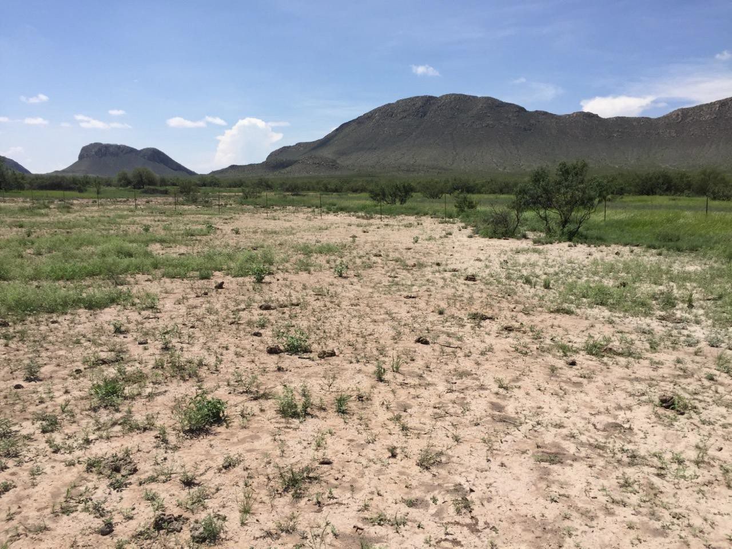
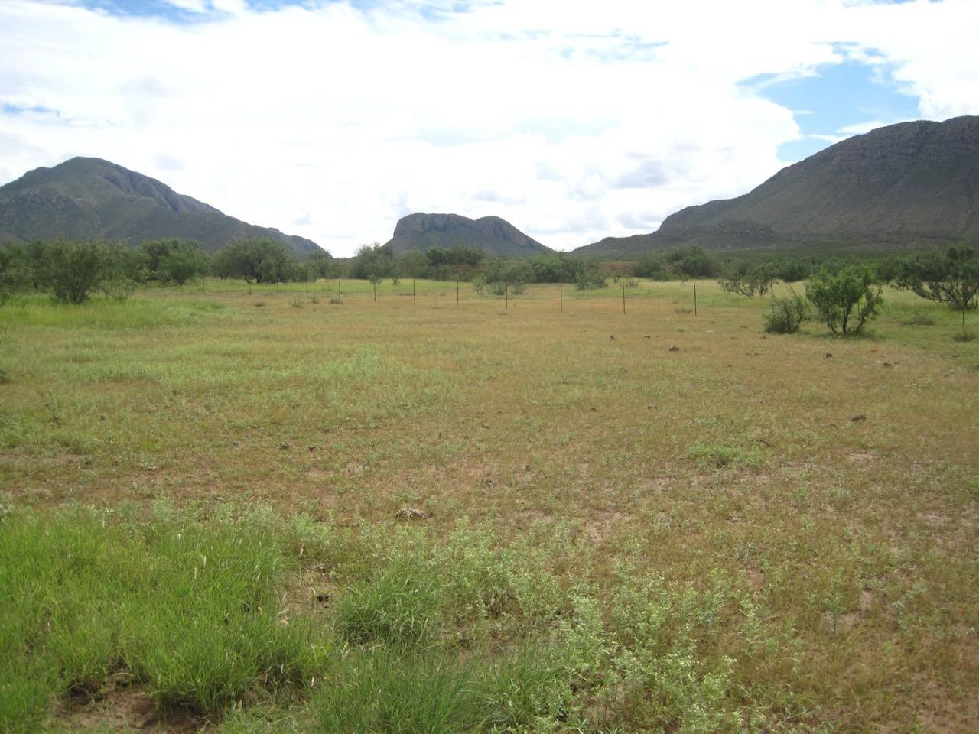
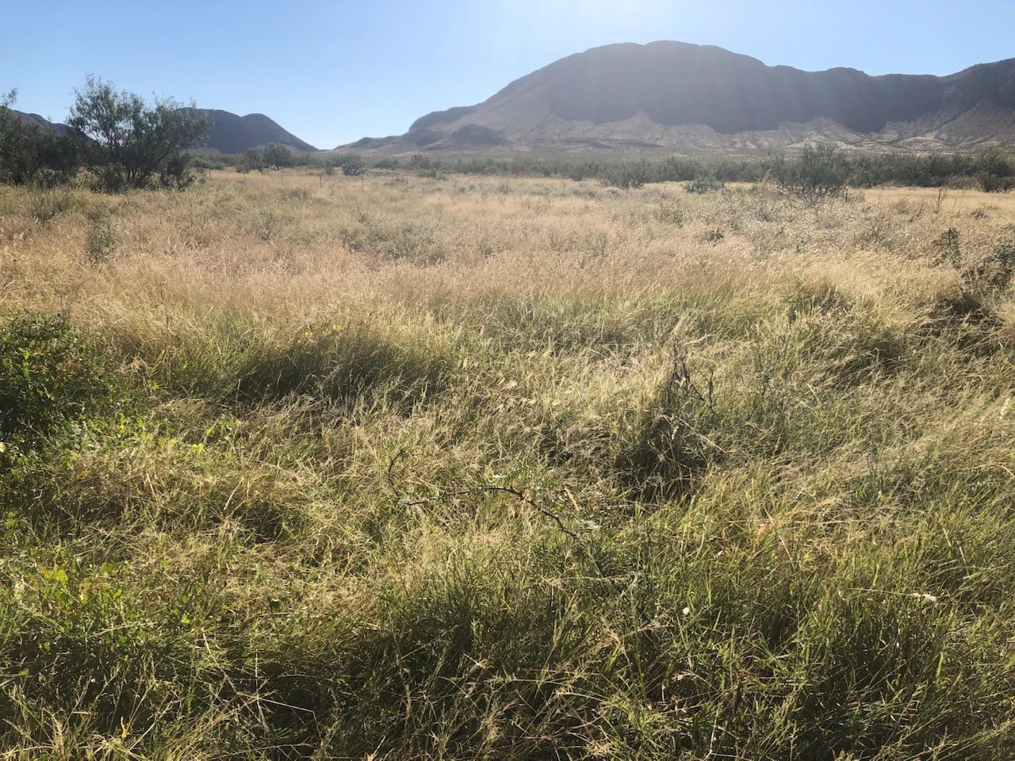
Closing Questions & Guidance
Las Damas Ranch
Chihuahua Desert, Mexico
- 6in rainfall annually
Environmental Succession
1) 2015
2) 2018
3) 2021
1
2
2
3
Notes:
Healthy soils-pulling/storing massive amounts of carbon- increased water infiltration- drought proofing – changing the small water cycle-

Slide 8
MAJ ERIC CZAJA
eric.czaja@nps.edu
Notes:
LAST SLIDE

